Slide 1
Accounting – Must-know concepts & terminologies

Slide 2
01
Intro to Accounting
02
Types of Accounts
03
Golden rules of Accounting
04
Accounting terminologies

Slide 3

Accounting - Introduction
Recording transactions
Summarizing in Reports
Financial Data analysis
Stakeholder reporting

Slide 4
Accounting terminologies
+
-
DEBIT
Entry to increase
CREDIT
Entry to increase
Assets
Expenses
Entry to decrease
Liabilities
Income
Entry to decrease
Assets
Lability
Income
Expenses

Slide 5


Accounting terminologies
ASSETS
Resources owned & controlled by the business enterprise
E.g.: Land, machinery, furniture, stock, cash & bank balance
Types of Assets – Fixed assets, Current assets, Investments
LIABILITIES
Obligations of the company, payable to outsiders & to the owners
Ex: Owner’s capital, Borrowings, payments to suppliers, etc

Slide 6

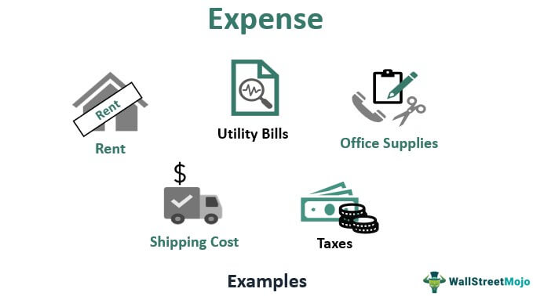
Accounting terminologies
INCOME
Money generated from sale of goods or services
Capital gains, ex: sale of fixed assets, stock investment, etc
Others like Interest, Royalty, etc
Expense is the cost incurred to generate revenue
Expenses are accounted for a period & cannot be carried forward

Slide 7
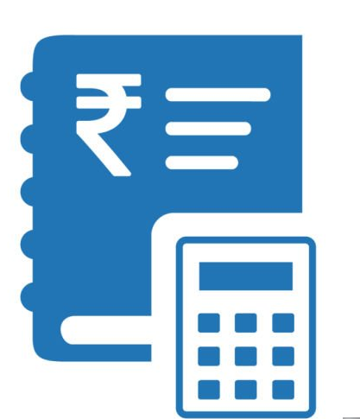
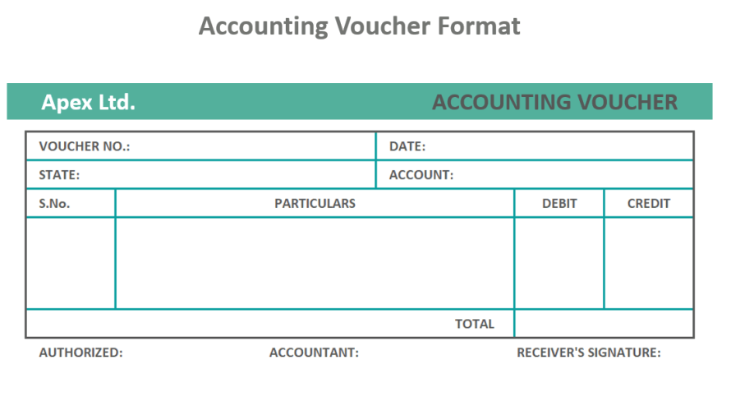
Accounting terminologies
ACCOUNT
Used to record the transactions
Ex: Cash a/c, Supplier a/c, etc
Each a/c has Debit & Credit
VOUCHER
Document serves as evidence of the transactions
Ex: Sales invoice, Payment voucher, etc

Slide 8


Accounting terminologies
Gross Profit
Revenue retained after deducting from cost of goods or services sold
Net profit
Revenue retained after deducting from all the other expenses
FINANCIAL Year/FISCAL year
One-year period used for financial accounting
In India, FY starts from April 1st & ends on March 31st

Slide 9
Types of accounts
Real
Account
1
Personal Account
2
3
Nominal Account
Natural persons’ a/cs
Artificial persons like firms, associations, etc
Assets, goods
Liabilities
Expenes, losses
Incomes , gains

Slide 10

Golden rules of accounting – Personal a/c
Akash traders bought goods from
Ravi Enterprises on credit basis
Debit the Receiver
Credit the giver
Debit Akash Traders
Credit Ravi Enterprises

Slide 11


Golden rules of accounting – Real a/c
Roshan electronics purchased office furniture & paid via Bank
Debit What comes in
Credit What goes out
Debit Furniture a/c
Credit Bank a/c

Slide 12

Golden rules of accounting – Nominal a/c
Shine Industries paid Salary to employees via Bank
Here credit is bank, its related to real account, credit what goes out
Debit the Expenses & loss
Credit the income & gain
Debit Salary a/c
Credit Bank a/c

Slide 13

Exercise
A/C type & Dr or Cr applicability
Office Rent a/c
Nominal A/C
Debit
Sales a/c
Nominal A/C
Credit
Employee Salary
Nominal A/C
Debit
Supplier’s a/c
Personal A/C
Credit
Cash Received
Real A/C
Debit

Slide 14
Exercise
A/C type & Dr or Cr applicability
Owner’s Drawings a/c
Personal A/C
Debit
Inventory (C/S)
Real A/C
Debit
Plant & Machinery
Real A/C
Debit

Slide 15
Accounting & Finance in TallyPrime Part I - Basics

Slide 16





Agenda
Company creation
Chart of accounts
Accounting vouchers
Financial reports
Basic MIS reports

Slide 17
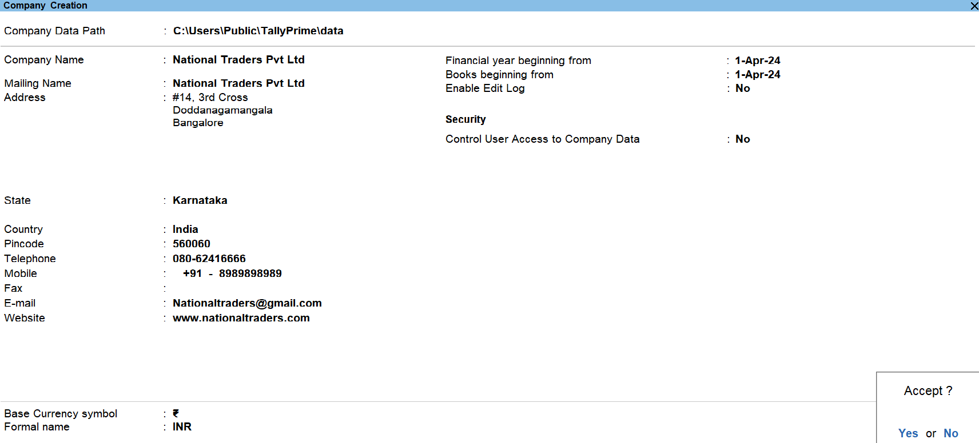
Company creation

Slide 18

Company creation – Important points
Company is created to keep record of all the business transactions
The mailing details like company name, address & contact details are required to print on the Invoices & Reports
Country is selected based on the customer’s business location
Based on country selected, books beginning will pick current financial year

Slide 19
Company creation – Important points
User can enter the different Books beginning date from which transactions to be accounted
Based on country selection, the base currency will be set in which transactions would be recorded
User can set-up additional configuration pressing F12
Security can be set for the company data to be accessed
Company features can be set based on business needs

Slide 20
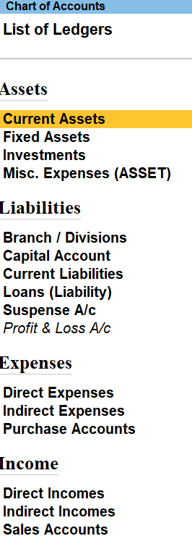
Chart of accounts
Assets
Liabilities
Income
Expenses
Chart of Accounts (COAs) is a list of all the financial accounts of a business

Slide 21
Chart of accounts
TallyPrime provides indexed list of masters – Accounting, Inventory, Payroll masters.
1
User can create the chart of accounts or masters as per the business requirement
2
1
By default, TallyPrime, provides below default masters –
Groups
Ledgers
Cost centres
Voucher types
Cost category
Batch
Godown
3

Slide 22
Chart of accounts – Accounting group
Group is an accounting head under which ledgers are classified
What is a Group?
28 Predefined groups out of which 15 are primary groups and 13 are sub-groups
Default groups in TP
15 primary groups
9 groups – capital in nature
6 groups – revenue in nature

Slide 23
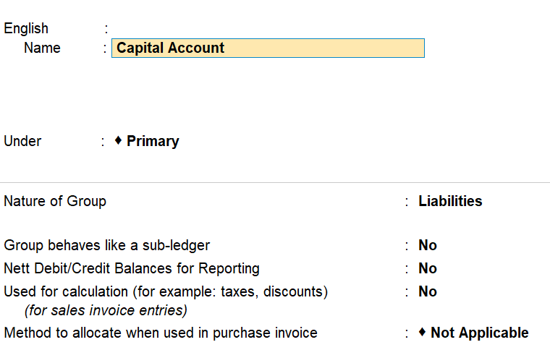
Chart of accounts – Accounting group
01
Default groups display
Gateway of Tally → Masters →Chart of Accounts
02
Group creation & configurations
Gateway of Tally → Masters →Group →Create
03
Group alteration
Gateway of Tally → Masters →Group →alter

Slide 24
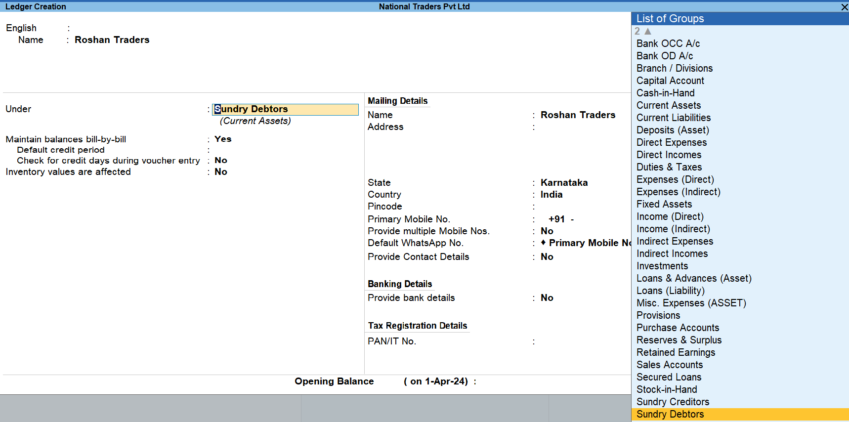
Chart of accounts - Ledger
Ledger – Ledgers are the accounts created to record the vouchers. Ex: Purchase, Sales, Customers a/c, etc.
Predefined ledgers – Cash a/c & Profit & Loss a/c
Ledgers are created using the accounting groups – default or user-created group
Based on ledger group, configuration will be applicable

Slide 25
Chart of accounts – Ledger (product walk through)
1
3
5
Single ledger Creation
Sales & Purchase
Income & Expenses
Bank a/cs
Ledger F12 configuration
Ledger deletion
Multi-ledger creation
Customers & Vendors
Ledger alteration
2
4

Slide 26

Chart of accounts – Stock Item (Product walkthrough)
Quantified using UOM (Units of measure)
Opening balance can be
entered in Stock items
Stock Items are created to track the Inventory

Slide 27
Accounting Vouchers – Predefined in TallyPrime
Contra
Payment
Receipt
Purchase
Journal
Sales
Credit note
Debit note
Accounting Voucher is a document used to record a financial transaction. It includes date of the transaction, amount, description & the approvals.

Slide 28
Accounting vouchers – Product walkthrough
CONTRA
Contra entry is a transaction involving transfer of cash between one Cash A/c to another or one Cash A/c to another
Includes transfer of -
Cash account to Cash account
Cash account to Bank account
Bank account to Cash account
Bank account to Bank account
PAYMENT
Used to account all the payments made by the company by way of Cash/Bank.
Examples -
Supplier payments
Recurring expenses like rent, maintenance, etc.

Slide 29
Accounting vouchers – Product walkthrough
RECEIPT
Used to record the money received by the organization
Examples-
Payments from customers via cash or bank
Non-operating incomes like dividends, interest, gain on sale of assets
Others
JOURNAL
Used to record adjustments, corrections, internal transactions, accruals, etc.
Examples -
Adjustments – Depreciation, Statutory adjustments like GST liability, etc
Corrections – Errors in any transactions
Internal transfers – Allocation of expenses to different depts
Accruals – Expense booking like salary

Slide 30
Accounting vouchers – Product walkthrough
SALES
Used to record the sale of goods or services as on date
Types of Sales voucher
Cash sales
POS
Credit Sales
CREDIT NOTE
Used to record sales returns or corrections in the sales/purchase invoices
Examples -
Returns – fully or partial
Corrections – Reduction in sales value, Increase in purchase value

Slide 31
Accounting vouchers – Product walkthrough
PURCHASE
Used to record the purchase of goods or services as on date
Types of purchase voucher
Cash purchase
Credit purchase
DEBIT NOTE
Used to record purchase returns or corrections in the sales/purchase invoices
Examples -
Returns – fully or partial
Corrections – Increase in sales value, Decrease in purchase value

Slide 32
Accounting Vouchers – Features
8 types of Predefined voucher
Modes for Contra, Payment & Receipt & Journal
Single entry
Double entry
Invoicing modes
Item invoice mode
Accounts invoice mode
Voucher mode
F12 configurations specific to voucher type
User can create sub voucher types as per business requirement
Ex: Local sales, International sales

Slide 33
Exercise
Transaction Vs Voucher type
Goods sold on Credit
Sales
Dr. Party Cr sales
Payment received via Bank a/c
Receipt
Dr Bank a/c Cr Party
Depreciation charged on Machinery
Journal
Dr. Depreciation a/c Cr. Fixed asset a/c
Returning goods purchased
Debit Note
Dr. Supplier a/c Cr. Purchase a/c

Slide 34
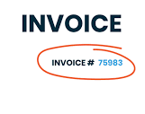
Voucher numbering methods
AUTOMATIC
Jupiter
Saturn
NONE
MANUAL
AUTOMATICMANUAL OVERRIDE
Venus
Mars
MULTI-USER AUTO

Slide 35
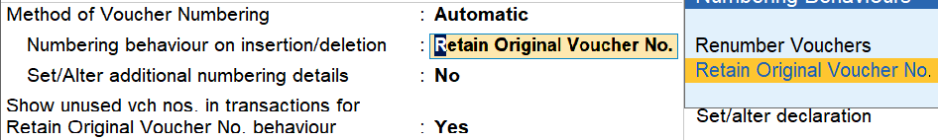
Automatic
Automatic is defaulted in all voucher types; Voucher numbers starts from 1 and is incremented automatically in all vouchers
Numbering behaviour on insertion/deletion
Renumber vouchers
Retain original voucher numbers

Slide 36
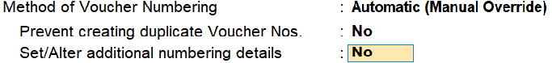
Automatic manual override
Automatic Manual Override is used when the user wants to automate the number as well as edit the number.
Example: if the voucher is auto-numbered as 10, you can manually change it to 21. The next voucher number will be 22.

Slide 37

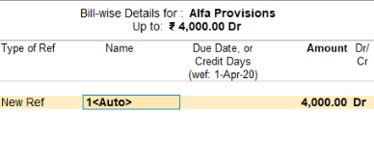
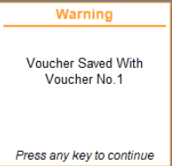
Multi-user Auto
It is extension to Automatic voucher numbering method
Selected to allocate the Invoice numbers in Multi-user environment

Slide 38

Financial reports
A financial report is a detailed document that shows a company's financial activities, performance, and condition over a specific period. It provides insights into the company's operations, profitability, cash flows, and financial health
In TallyPrime, based on vouchers entered the financial reports get updated on real-time

Slide 39
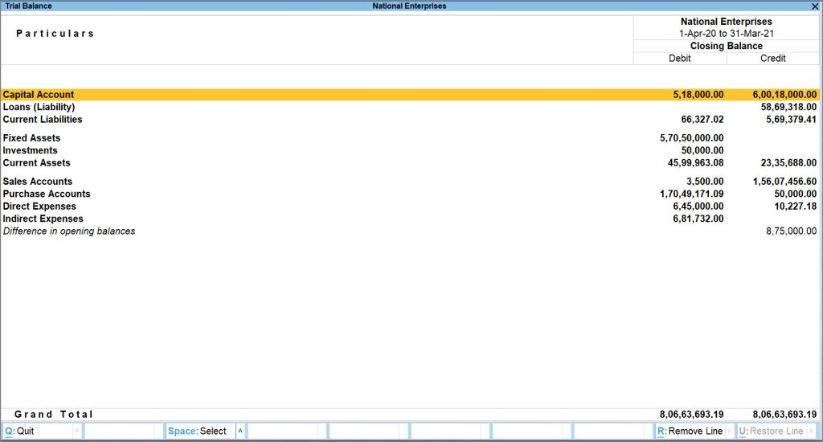
Financial reports – Trial Balance
Summary of all the ledger balances
Ledger wise view
F12 Comparison
Compare/Monthly view

Slide 40
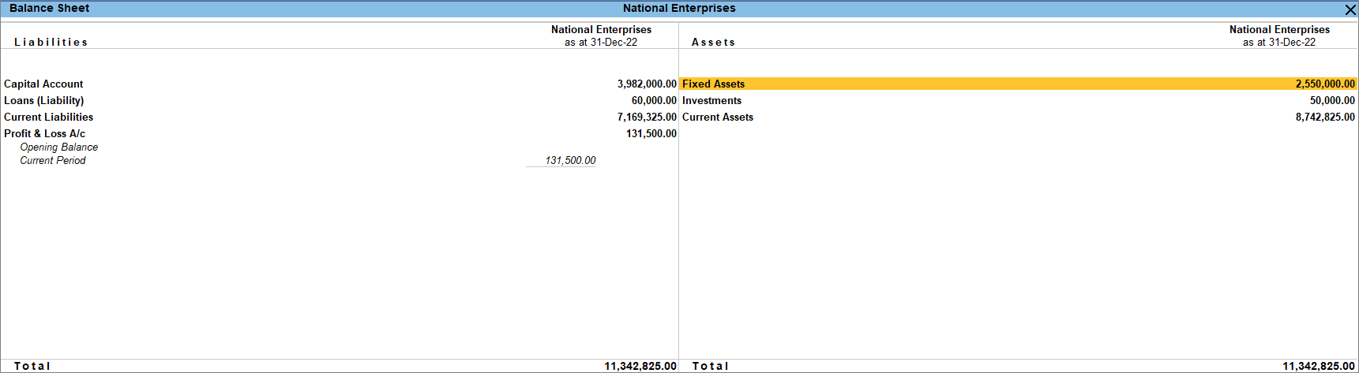
Financial reports – Balance Sheet
Presents the financial position of the company
It contains company ASSETS, LIABILITIES & EQUITY
Vertical B/S
Compare
Stock valuation methods
Scale factor
Working capital
F12 configuration

Slide 41
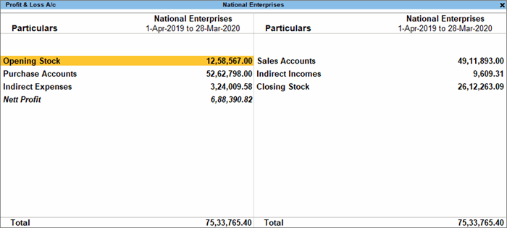
Financial reports – Profit & Loss a/c
Summary of Income & Expenses for specific period
Shows the profit or loss from business operations
Also known as Income statement
F12 Configuration
Comparison
Income & Expenditure statement

Slide 42
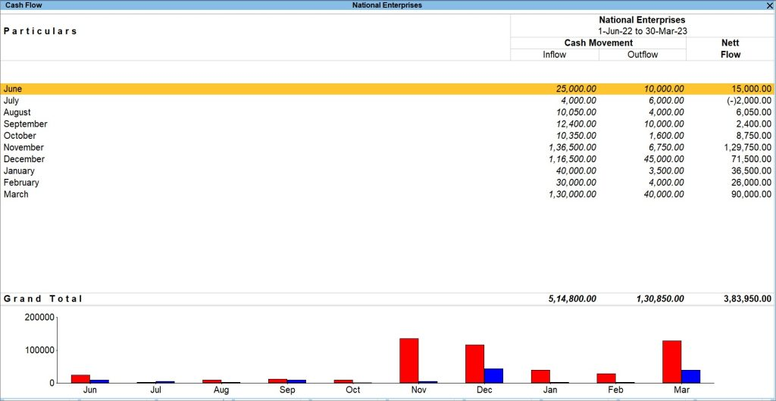
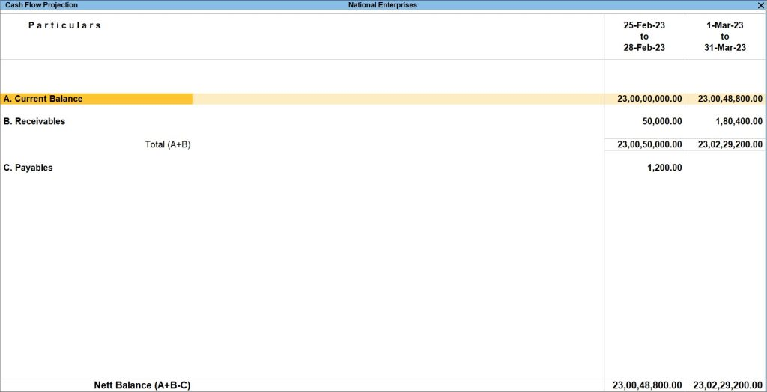
Financial reports – Cash flow & Cash flow projection
Cash flow – Inflow & Outflow of cash for the period
Cash flow projection – It is a forecast report helping to anticipate the cash to be generated or spent over a period of time.

Slide 43
Basic MIS reports
1
Voucher Statistics
2
Outstandings
3
CASH & BANK book
4
Fund flow
5
Registers
6
DayBook
Product walkthrough

Slide 44

Part II – Advanced

Slide 45
AGENDA
Interest Calculation
Multi-currency
Credit limits
Cost Centres
3
4
Outstanding Management
2
5
Budgets
1
6

Slide 46
Bill-wise (Outstanding management)

Slide 47


Outstanding Management – Bill-wise in TallyPrime
Bill-wise refers to Tracking & managing transaction-by-transaction. This helps in identifying which bills have been paid and which are still due.

Slide 48
Bill-wise (Product walkthrough)
Enabling in company F11
Enabling in customer & supplier ledgers
Transaction recording
Tracking in receipts & payments
Bill-wise scenarios
Bill-wise reports
Reminder letters

Slide 49
Bill wise – types of references
New
Against
Advance
On-account
Select when you are recording a fresh transaction, to generate a new bill for the party.
Select in payment or receipt to account advance payment paid or received
Select when you need to adjust the transaction against a bill (advance received, credit note, etc.).
Select when you want to save the sales invoice without any bill reference.

Slide 50




Bill-wise scenarios
1
Mr. Ram is an accountant in National Traders, started maintaining accounts in Tally since 1st April 2024. Mr. Ram wants to bring forward the last year pending bills of ledgers to 1st April.
Ledger opening balance with Bill-wise break-up

Slide 51
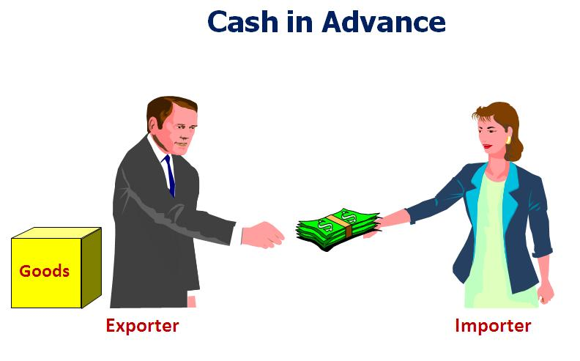
Bill-wise scenarios
2
Ms. Anitha from National traders is making advance payment to Roshan enterprises for sending Goods.
Advance
Payment
Seller
Buyer
Against
Purchase

Slide 52

Bill-wise scenarios
3
National traders have raised a Sales invoices against Arun Traders for the goods worth INR 10000. Arun Traders have made partial payment of INR 7000 against the invoice
Edit the amount in receipt voucher against the Bill

Slide 53


Bill-wise scenarios
4
Generate Reminder letter from outstanding reports
Single ledger
Alt+G: Go To → Ledger outstandings → select Ledger →Alt+P: Print →Current →Configure → Report type as “Reminder letter”
Multi ledgers
Alt+P: Print→ Others → Group of Ledger outstandings → Sundry Debtors → Configure → Report type as “Reminder letter”

Slide 54

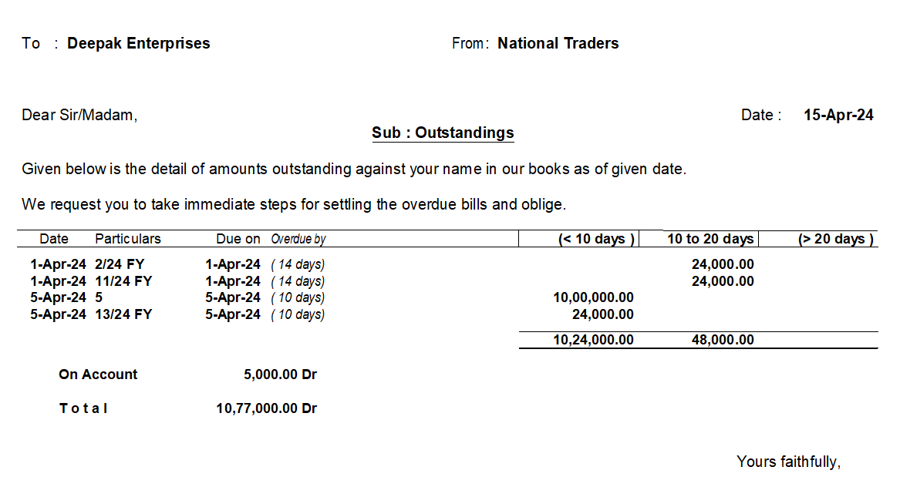
Bill-wise scenarios
4

Slide 55

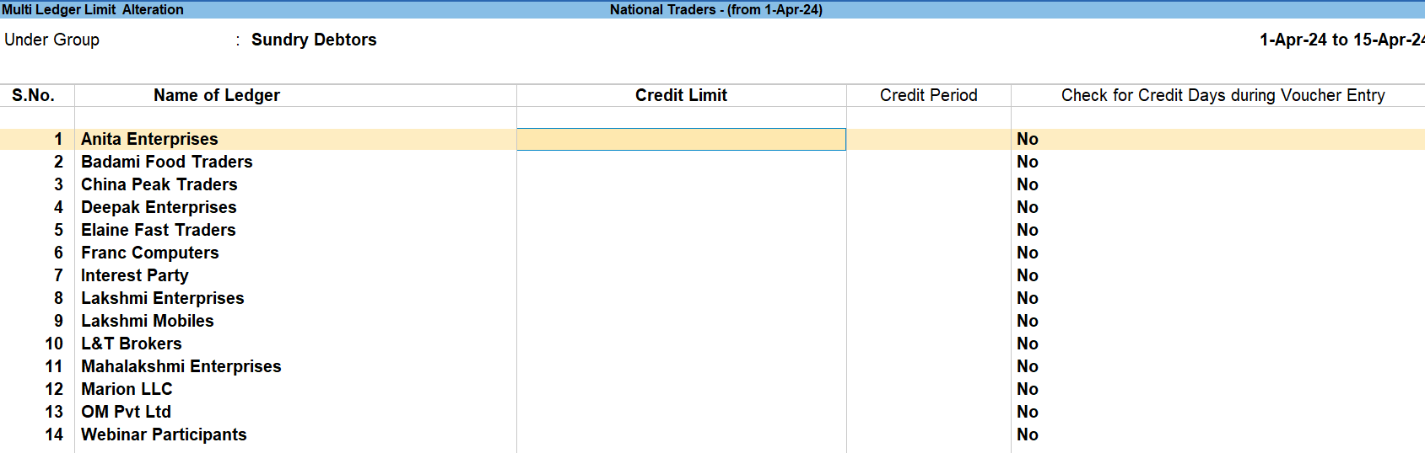
Bill-wise scenarios
5
Credit limit is the maximum amount
of credit extended to a buyer.
National Traders providing option for suppliers, allowing them to purchase materials on credit and pay later.
Credit Limits in Ledgers

Slide 56
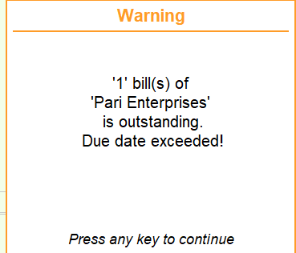
Bill-wise scenarios
5
CREDIT LIMIT
Total amount of credit allowed for a customer
CREDIT PERIOD
Duration given by supplier to buyer to pay the amount against the goods/services purchased on credit basis.
CHECK FOR CREDIT DAYS
Enabled to check if credit limit is exceeded for the ledger
Ex: National traders allowing total credit of 1 lakh to Roshan enterprises for the year
Ex: National traders allowing credit days as 5 days from date of invoice
Also shows the amount that has been exceeded

Slide 57
Bill-wise scenarios
6
National Traders want to restrict selection of “On-account” references in the vouchers.
Security control steps
Login to company from admin level
Navigate to Alt+K: Company > User Roles
Select the User role in which LAN users are created
Enable the option “Exclude on account from Bill allocations”

Slide 58
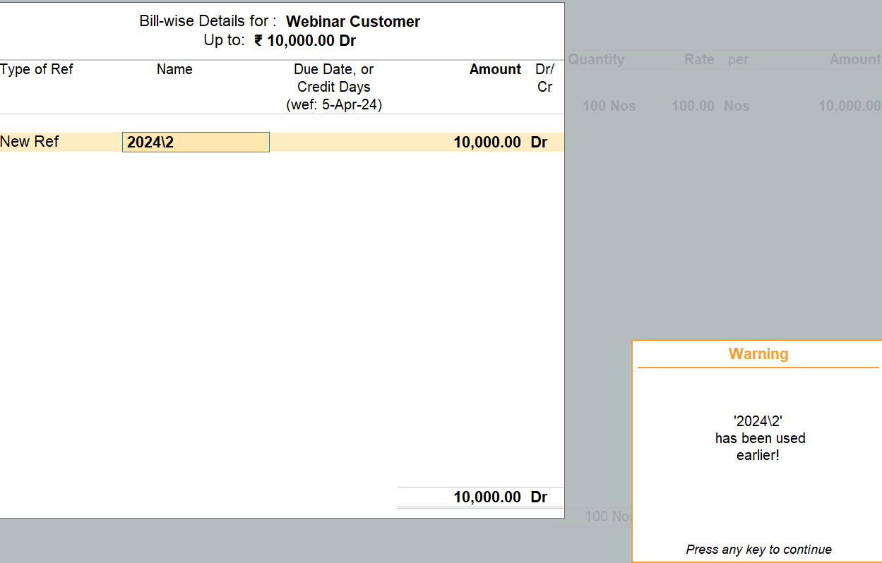
Bill-wise scenarios
7
Duplicated the sales or purchase invoice from Daybook, the Bill reference is unchanged, why?
The Bill reference does not get changed automatically on duplication; user must change manually before saving

Slide 59

Bill-wise scenarios
8
National Traders opted for Bank loan from SBI Bank. They want to track the Loan amount received & the monthly EMI paid
Under Loan ledger → Press F12 → Enable the option bill wise

Slide 60
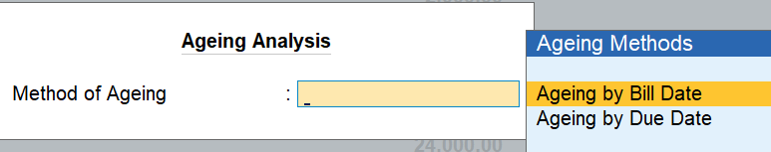

Bill-wise scenarios
9
National Traders want to understand the pending bills age or length of the time an invoice is due
Ageing analysis report
By Bill date
Considers Voucher date & To period applied in report
By Due date
Considers Due date & To period applied in report

Slide 61
Exercise
Reference used for adjusting the bills
Against Reference
01
To understand the bills pending based on age
Ageing analysis
02
Want to remind customers about the upcoming invoices due for payment
Reminder letter
03

Slide 62
Exercise
Can we hide “On-acount” reference from selection
Yes, from Security control
04
Should the Bill reference be unique across years data?
Yes
05
If I duplicate the invoice, does bill reference gets new number?
No, user must change manually
06

Slide 63
Interest Calculation

Slide 64


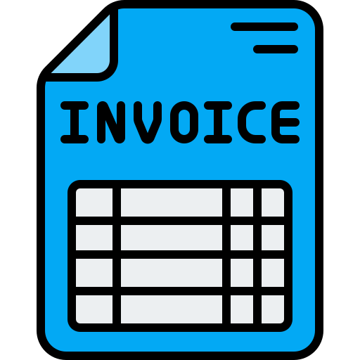

Interest calculation scenarios
National Traders
Ex Traders
Interest charged on late payment

Slide 65


Interest calculation scenarios
Bank Manager
National Traders
Interest charged
on Bank loan, Bank Overdraft a/c

Slide 66
Businesses might need to pay or receive the interest on Loans taken or on invoice late payments. Interest calculation feature will automate the interest calculation
01
Enable Interest calculation & specify parameters
03
In Company level
Iinterest check & accounting
Party /Loan ledger
02
Check auto calculated interest from report & record Debit note for Interest receivable & credit note for Interest payable
“Interest calculation” under F11 company features. Also Bill wise is mandatory to track the interest against bills

Slide 67

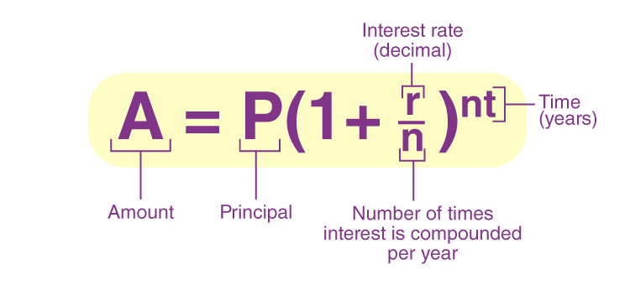
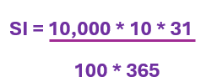
Interest Calculation – Types of Interest
Simple Interest
Calculates interest on the principal amount at a fixed interest rate
Compound Interest
Calculates interest on the Principal amount & the accumulated interest

Slide 68
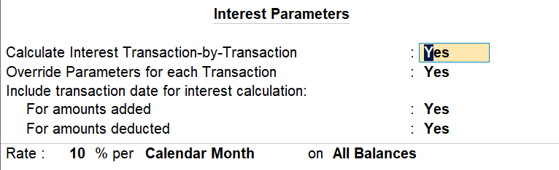
Interest Calculation – Interest Parameters for Party ledger
SIMPLE PARAMETERS

Slide 69
Simple parameter
Calculate Interest transaction-by-transaction
Enabled when user wants to apply interest calculation on every invoice raised for the customer
Override parameters for each transaction
Allows user to modify/change the interest parameters at transaction level
Include transaction date for interest calculation
Enabled by user when the interest must be charged on the payable amount only.
Ex: For a customer, an invoice was raised for Rs. 50,000 on the 1st of April 2024, against which Rs. 20,000 was received on the same day. Now you may want to include the invoice amount and exclude the received amount, for the purpose of calculating interest on 1st April 2024.

Slide 70
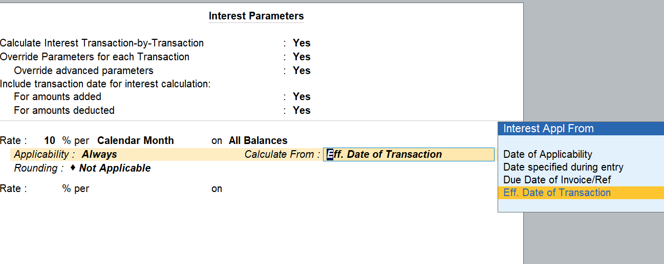
Interest Calculation – Interest Parameters for Party ledger
ADVANCED PARAMETERS

Slide 71
Product walkthrough

Slide 72
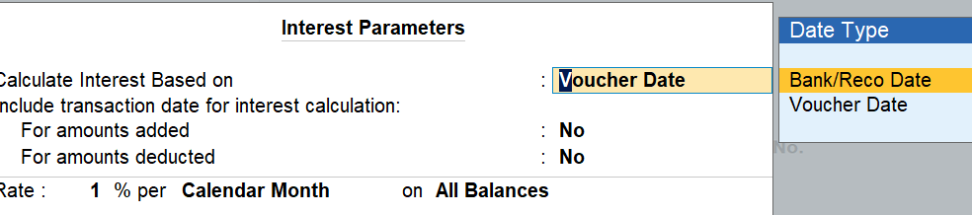
Interest Calculation – Interest Parameters for Bank ledger
SIMPLE PARAMETERS

Slide 73
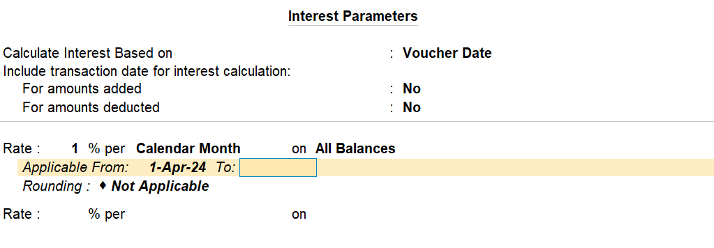
Interest Calculation – Interest Parameters for Bank ledger
ADVANCED PARAMETERS

Slide 74
Exercise
01
Can we charge interest post the due date of the invoice?
Yes, Need to set advanced parameters in the ledger master
02
What is the use of selecting “Bank Reco date” in the bank ledger for interest calculation
Based on Bank Reco date , the interest starts calculating for the voucher

Slide 75
Exercise
03
Can I set multiple interest rates in party ledger & select during voucher entry?
Yes, Need to set advanced parameters in the ledger master
04
Which voucher type is used to account Interest receivable?
Debit note

Slide 76
Multi-currency

Slide 77




Intro to Multi-currency
Selling goods to USA
National Traders, India

Slide 78
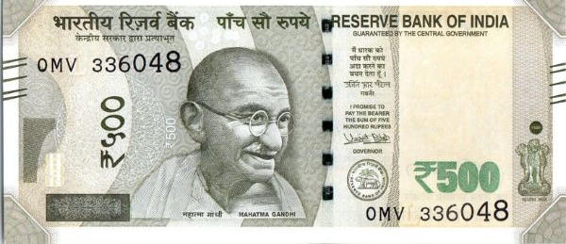



Intro to Multi-currency
Business dealing with different geography customers & suppliers, hence trading in different currencies

Slide 79
Multi-currency in TallyPrime
Currency creation
Set rate of exchange in currency <optional>
Voucher with currency in rate field
Provide rate of exchange
Print the invoice

Slide 80
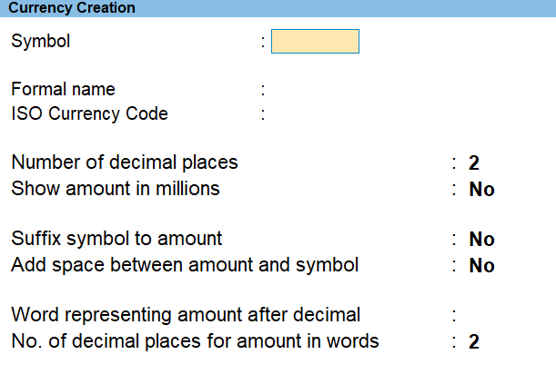





Currency creation
Ctrl + 4
Shift + 4
Alt + 0128
(Numeric keyboard only)
Alt + 0165
(Numeric keyboard only)
Alt + 0163
(Numeric keyboard only)

Slide 81
Rate of exchange - Terminologies
What is exchange rate?
Rate at which one currency can be exchanged for another
Ex: 1 US$ = 83.46 ₹
Why are exchange rate used in voucher?
To determine the cost of purchase or the revenue likely to earn from sales
What is Standard Rate of Exchange?
Rate at which one currency can be exchanged for another in FOREX Market

Slide 82
Rate of exchange - Terminologies
Selling rate of exchange
Rate at which Bank or Forex dealer wants to sell one currency for ₹
Buying rate of exchange
Rate at which Bank or Forex dealer wants to buy a foreign currency paying in ₹

Slide 83
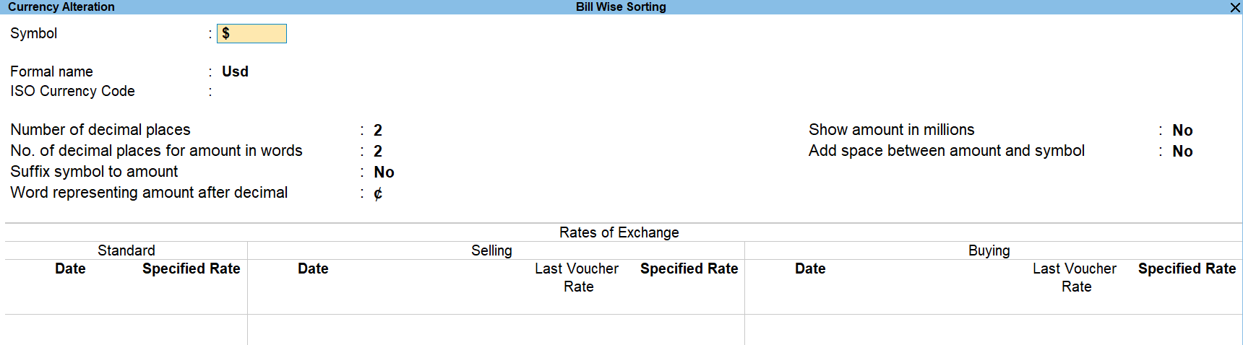
Rate of exchange configuration
It is optional to configure the Rate of exchange, as the user can enter during voucher entry as well

Slide 84
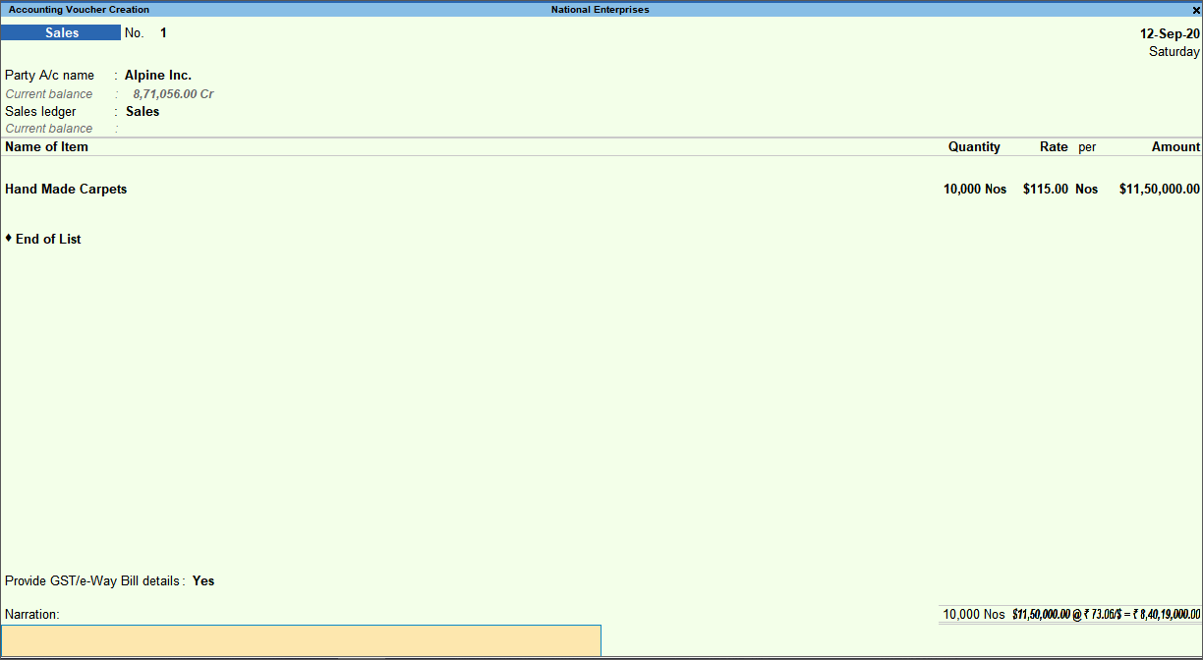
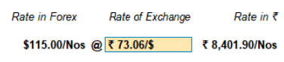
Voucher entry – Sales/Purchase

Slide 85
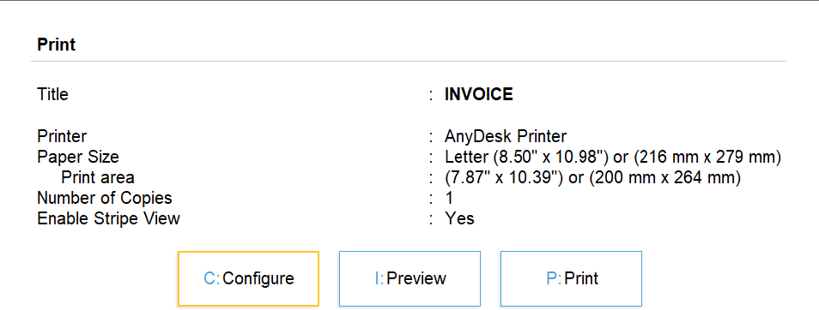
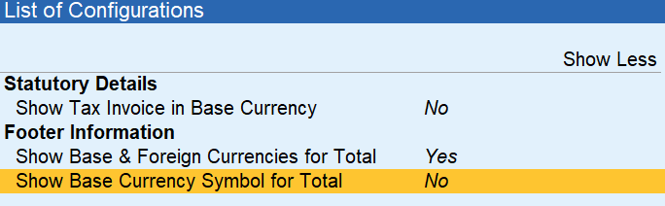
Invoice print configuration

Slide 86
Forex gain/loss
What is Forex gain/loss?
Forex gain or loss is the profit or loss that happens when the exchange rate between two currencies changes during invoicing and when the amount is actually paid or received.
SL No | Transaction type | Rate of exchange | Cost of $ in ₹
1 | Sales – 100$ | 80₹\1$ | 8000₹
2 | Receipt – 100$ | 82₹\1$ | 8200₹
 |  | Forex gain\loss | 200₹

Slide 87
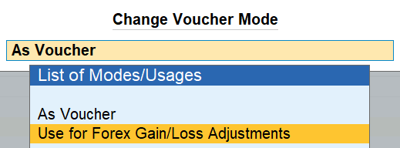
Treatment of Forex gain/loss
Accounting standards 11 applicable for forex gain/loss
Forex gain or loss arised due to difference in rate of exchange should be accounted in Profit & loss statement
JOURNAL

Slide 88
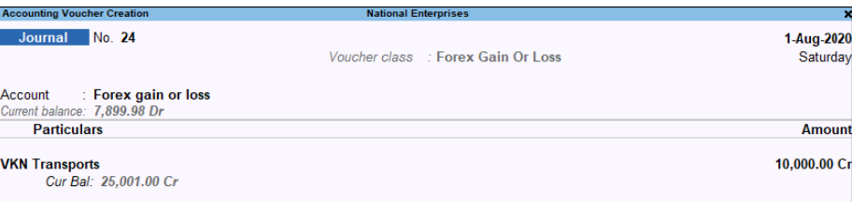
Forex gain/loss adjustment entry

Slide 89
Product walkthrough

Slide 90
Understanding Forex gain/loss calculation
There are 3 methodologies to calculate the Forex Gain\Loss a/c
01.
Realized Gain/loss – Difference of exchange rates between Sales – Receipt , Purchase – Payment
02.
Unrealized Gain/loss – Difference of exchange rates between Sales\Purchase with Standard rate of exchange
03.
Unrealized Gain/loss – Difference of exchange rates between Sales\Purchase with latest rate of exchange from transactions

Slide 91
Exercise – Answer in a word
1. Tally calculates Forex gain/loss on pending bills
2. Accounting forex gain/loss is optional for the business
3. You can maintain single ledger to account gain/loss
TRUE
FALSE
TRUE
4. If Standard rate of exchange is unavailable, Tally considers which rate of exchange?
Latest rate of exchange entered in any voucher to calculate gain/loss on the pending bills

Slide 92
Exercise – Answer in a word
5.Do Tally has provision to calculate forex gain/loss only on realized bills?
6. User should close the adjustments before moving to new financial year
NO
TRUE

Slide 93
Cost Center Management

Slide 94
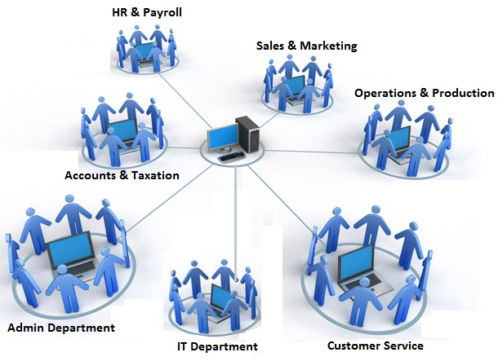
Introduction to Cost Centers
Expenses incurred in different departments are accounted using Cost Centre
Allocation of expenses to respective units will help to analyze the costing

Slide 95






Introduction to Profit Centres
A Profit Centre is a business segment or unit that is responsible for generating revenue & managing its own cost.
This concept allows companies to evaluate the profitability across departments, products, regions, etc

Slide 96
Cost Centers in TallyPrime
Enable in F11> Company features
Cost Category
Cost Centre
Used for parallel allocation
Ex: Production dept & associated cost like materials cost, supplies, labour, etc
Optional to enable
Create cost centres
Enabling cost centres in ledgers
By default, Income & Expense ledgers
Cost Centre allocation in Vouchers
Cost Centre report

Slide 97

Cost Centre scenarios
I want to allocate expenses & revenue related to Sales department
Create Sales department as Cost Centre
Allocate cost center in Payment\Journal\Sales\Purchases\Receipt vouchers

Slide 98

Cost Centre scenarios
I want to know revenue generated by salesmen
Create Cost centers with salesman name. Ex: Ramesh, Sunil, etc.
Allocate cost centers in Sales vouchers

Slide 99

Cost Centre scenarios
I want to know how I can extract revenue generated by salesmen of my different retail stores
Cost Centre
Retail store 1 (Primary CC)
Anil
(Sub-CC)
Sunil
(Sub-CC)
Retail store 2(Primary CC)
Ramesh
(Sub-CC)
Suresh
(Sub-CC)

Slide 100

Cost Centre scenarios
Can I allocate Cost Centres in Purchases?
Cost Centre allocation is not possible in Purchase voucher
However, user can create a Cost Centre class & automate the allocation

Slide 101

Cost Centre scenarios
I need to enter the opening balance for Cost Centres
Cost Centre is primarily used for allocating expenses & income which are incurred for a period & are not carried forward. Hence, opening balance field does not exist in Cost Centre master
However, customers create cost center for various business scenarios. Ex: accounting employee salary, handling projects, etc.
Alternate solution: Record JV to account opening balance

Slide 102

Cost Centre scenarios
I want to disable the cost centres
Scenario 1
Scenario 2
Want to disable for specific ledgers
Do not want cost center allocation for any ledgers & wants to delete the cost centers
Enquire the reason → check for cost center report for transactions allocated→ inform to change the allocation→ disable cost center applicability in ledgers
Check if transactions exists in CC report → inform customer that CC cannot be deleted

Slide 103

Exercise
1
Can I enter opening balance under Cost Centre master?
Record JV to account opening balance as on 1st April
2
Can I delete the Cost Centre, if already used in transactions?
No, replace transaction with different Cost Centre & delete the unwanted Cost Centre
3
What is Sub Cost Centres?
Creating a Cost Centre under primary cost center for the classification & parallel allocation

Slide 104
Budget Management

Slide 105

What is a Budget?
A Budget is a financial plan detailing how much money company is expecting to earn & expenses expected to incur over a period.
Benefits of a Budget
Helps in managing the costs & Cost reduction
Helps in financial decision making
Performance measurement

Slide 106
Budget in TallyPrime
Creation levels
Accounting Groups
Cost Centres
Ledgers
To allocate budget for all ledgers created under a specific group. Ex: Indirect expenses
To monitor the allocated budget for individual ledger
To monitor department wise expenses & income

Slide 107


Budget scenarios
Mr. Arun, Finance manager at National Traders wants to set budgets for Expenses & Incomes. He wants to track the allocated budget value against the actuals income & expenses incurred. How do you help?
Solution
Create expense & income ledgers
Create budget at accounting group
Select type of budget – On Nett transactions\On Closing balance
Record vouchers to account actual expenses & incomes
Track the Budget Variance

Slide 108
Budget scenarios
Mr. Arun, Finance manager at National Traders wants to set budgets for a specific expense – Office supplies & track if expenses are in control. How do you guide?
Solution
Create expense ledger – Office supplies
Create budget at ledger level
Select type of budget – On Nett transaction\On Closing balance
Record vouchers to account actual expenses
Track the Budget Variance

Slide 109
Budget scenarios
Mr. Arun, Finance manager at National Traders wants to set budgets for expenses incurred by different departments. How do you guide?
Solution
Create expense & income ledgers
Create departments as Cost Centres
Select type of budget – On Nett transactions\On Closing balance
Record vouchers to account actual expenses & incomes
Track the Budget Variance

Slide 110
Budget Highlights
1
Budgets can be created for different periods
2
A budget can be altered or deleted any time
3
Budget value can be set at closing balance or on Net transactions
4
Budget variance view will help user to compare actuals with budgeted amount

